Slide 1
















ARAHAS - Where Sustainability Meets Technological Innovations
Arahas is a premier provider of Sustainability Technology, Geospatial, and AI services, boasting over two decades of proven expertise.
We are a wholly-owned subsidiary of Ever Enviro, supported by the Green Growth Equity Fund (GGEF), India's leading climate fund managed by Eversource Capital.
CMMI & ISO Certified Organization.
200,000 Hours of Consulting & Training
20+ Years of Experience
Platforms
City Sustainability Index, CSI Platform
Green Exchange, GeX Platform
Large Scale Operations in all Parts of Globe
Strong Network with Global Technology Partners
Services
Sustainable Development
IT Consulting
IT Solutions
Geospatial Solutions
AI & Advanced Data Analytics Solutions
Disaster Resilience
Solutions
Key Investors

Slide 2

In today’s times, urban centers face escalating sustainability challenges such as:
Climate change
Air pollution
Water scarcity
PROBLEM
Inefficient waste management
Deterioration of public services
Disaster-risks
City Sustainability Index (CSI), spearheaded by Arahas emerges as a comprehensive solution designed to empower cities with the tools to evaluate and enhance their sustainability performance while address these pressing issues.
EXECUTIVE SUMMARY
SOLUTION
CSI integrates:
Cutting-edge geospatial technology
Data Analysis
Sustainability Principles
Actionable Insights & Recommendations
TOOLS AND TECHNOLOGY
Through CSI, Arahas aspires to create a global standard for sustainable urban living, supporting cities in achieving their sustainability goals while preserving their unique cultural and environmental identities.
AIM

Slide 3

INTRODUCING CITY SUSTAINABILITY INDEX

Slide 4



VISION, MISSION, AND OBJECTIVES
VISION
MISSION
OBJECTIVES
To create a global standard for sustainable urban living by empowering cities with innovative tools to achieve resilience, inclusivity, livability and harmony between social and environmental stewardship for future generations.
To develop and implement cutting edge performance managed platform that enable cities to monitor, analyze, and optimize their sustainability initiatives effectively. we aim to design solutions that empower cities to achieve their sustainability goals.
Track and Analyze Sustainability Indicators
Ensure Compliance with Regulations
Promote Innovation
Measure the Impact of Initiatives
Contribute to Global Sustainability Goals

Slide 5
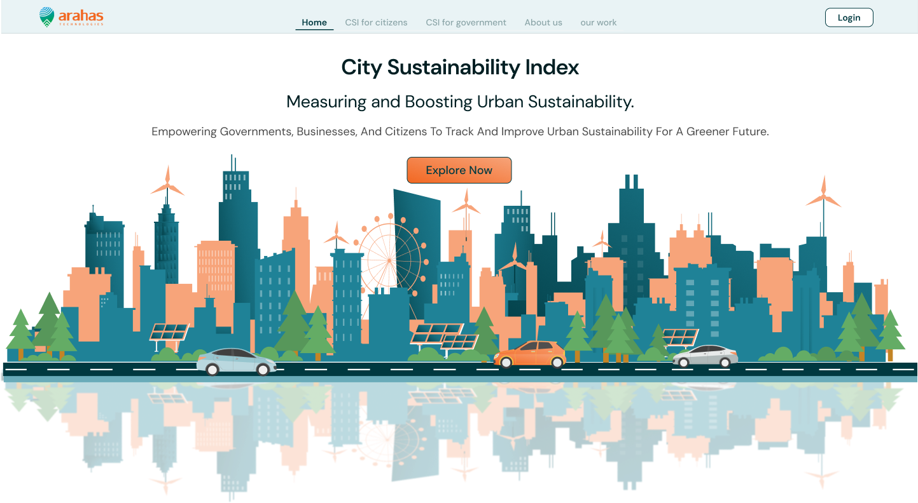

















Primary Focus

Slide 6
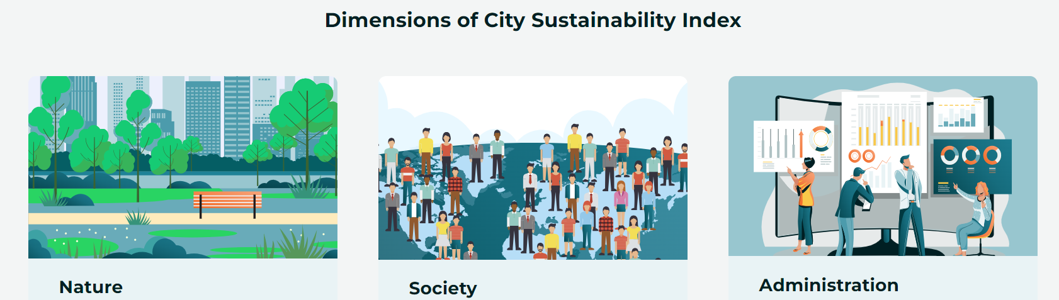





NATURE
SOCIETY
ADMINISTRATION
1
Framework architecture Construction
2
Data Collection and Processing
3
Benchmarking and Calculating score
4
Evaluation engine-Sustainability and insights
5
Generating Reports & Recommendations
“Empowering cities, empowering people!”

Slide 7
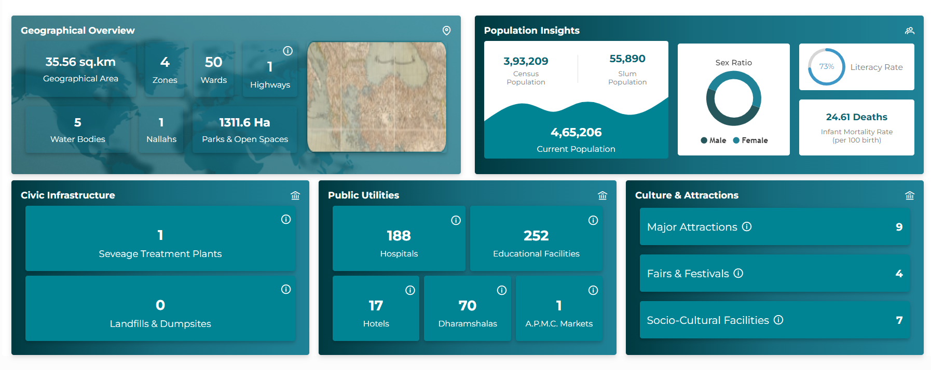
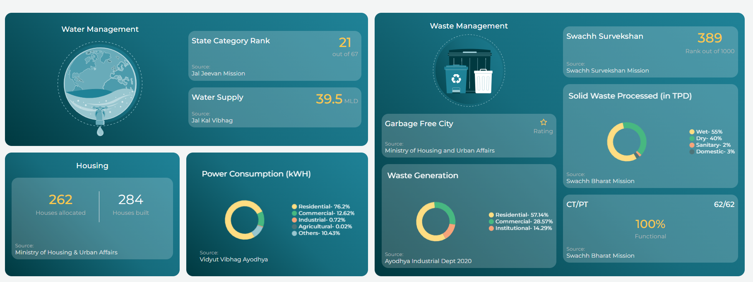
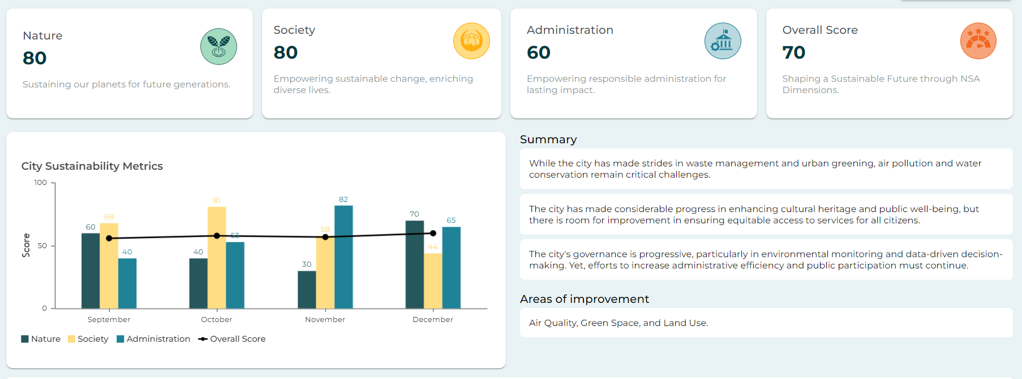
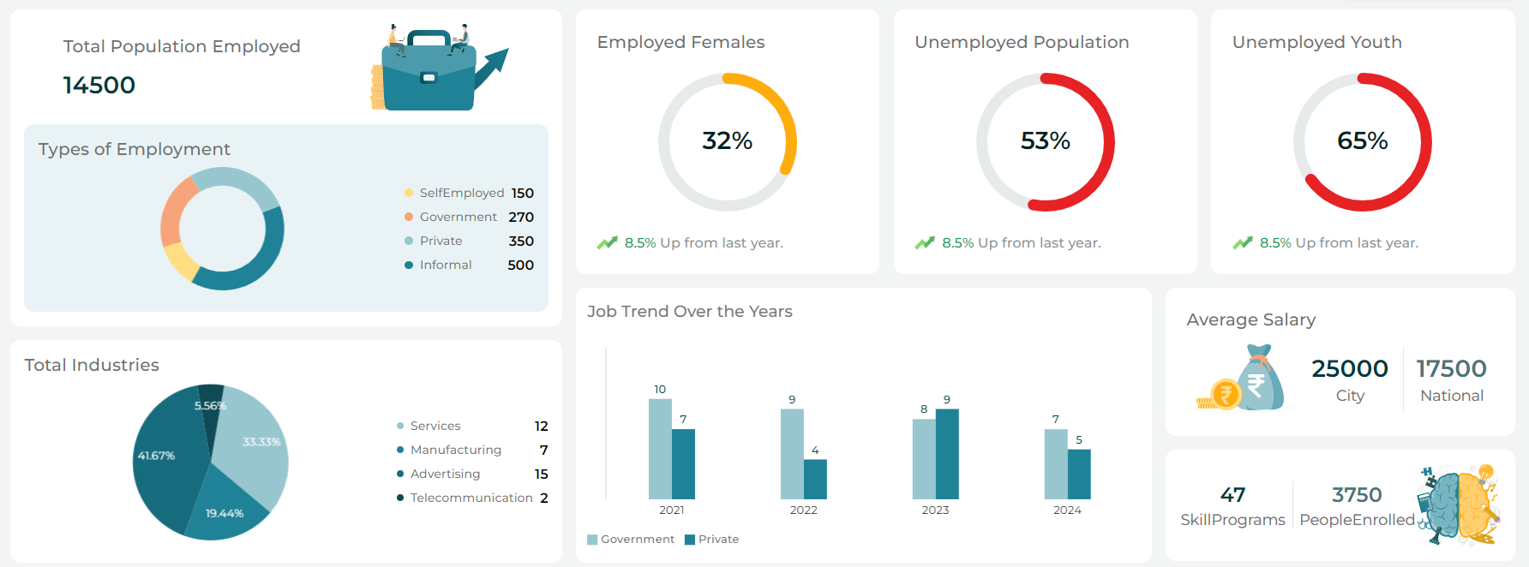
CSI FEATURES
1. Know your City
2. City Progress
3. City Report Card
4. Dashboards & Reports

Slide 8
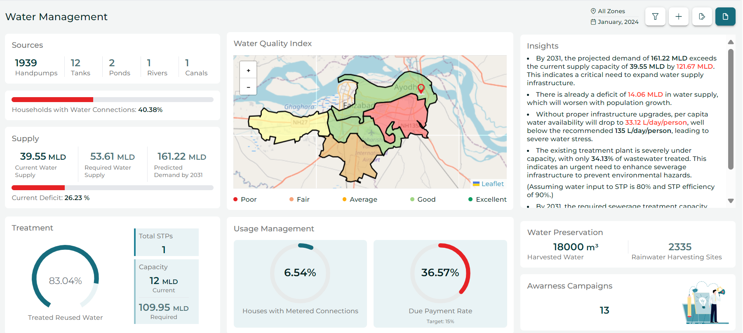








DASHBOARD FEATURES
CSI Score
Excellent performance
NEAR REAL-TIME INSIGHTS
INDEX SCORE
Quantifiable metrics
Composite Representation
Moderately well
Dynamic Data Updates
Actionable Feedback
Needs Improvement
RECOMMENDATION TOOL
COLOR CODING
*Real-time requires data warehouse availability
Categorization of Performance
Threshold-Based Evaluation
Personalized suggestions
Scenario Modeling

Slide 9
DASHBOARD FEATURES
Excellent performance
Moderately well
CSI Score
Needs Improvement
INDEX SCORE
COLOR CODING
NEAR REAL-TIME INSIGHTS
RECOMMENDATION TOOL
The CSI Score Is calculated by weighted average of Nature, Society and, Administration.
Easy visual impact and judgement
Threshold-Based Evaluation
Actionable Feedback
Dynamic insights
Gaps identifier
Performance-wise tailored recommendations
Available for all indicators
*Real-time requires data warehouse availability

Slide 10
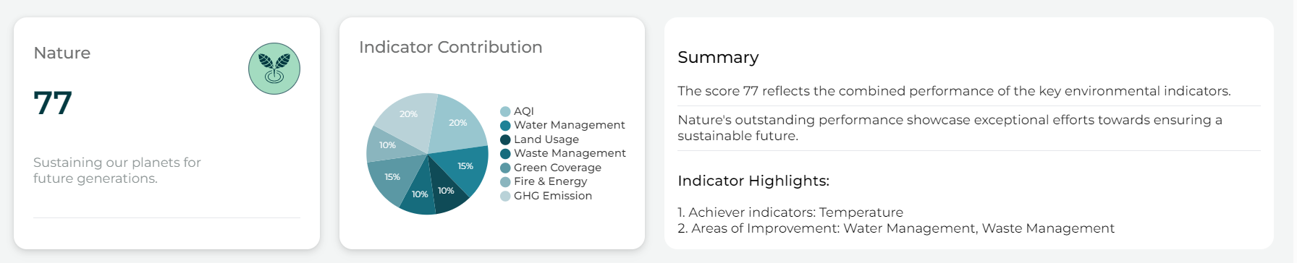
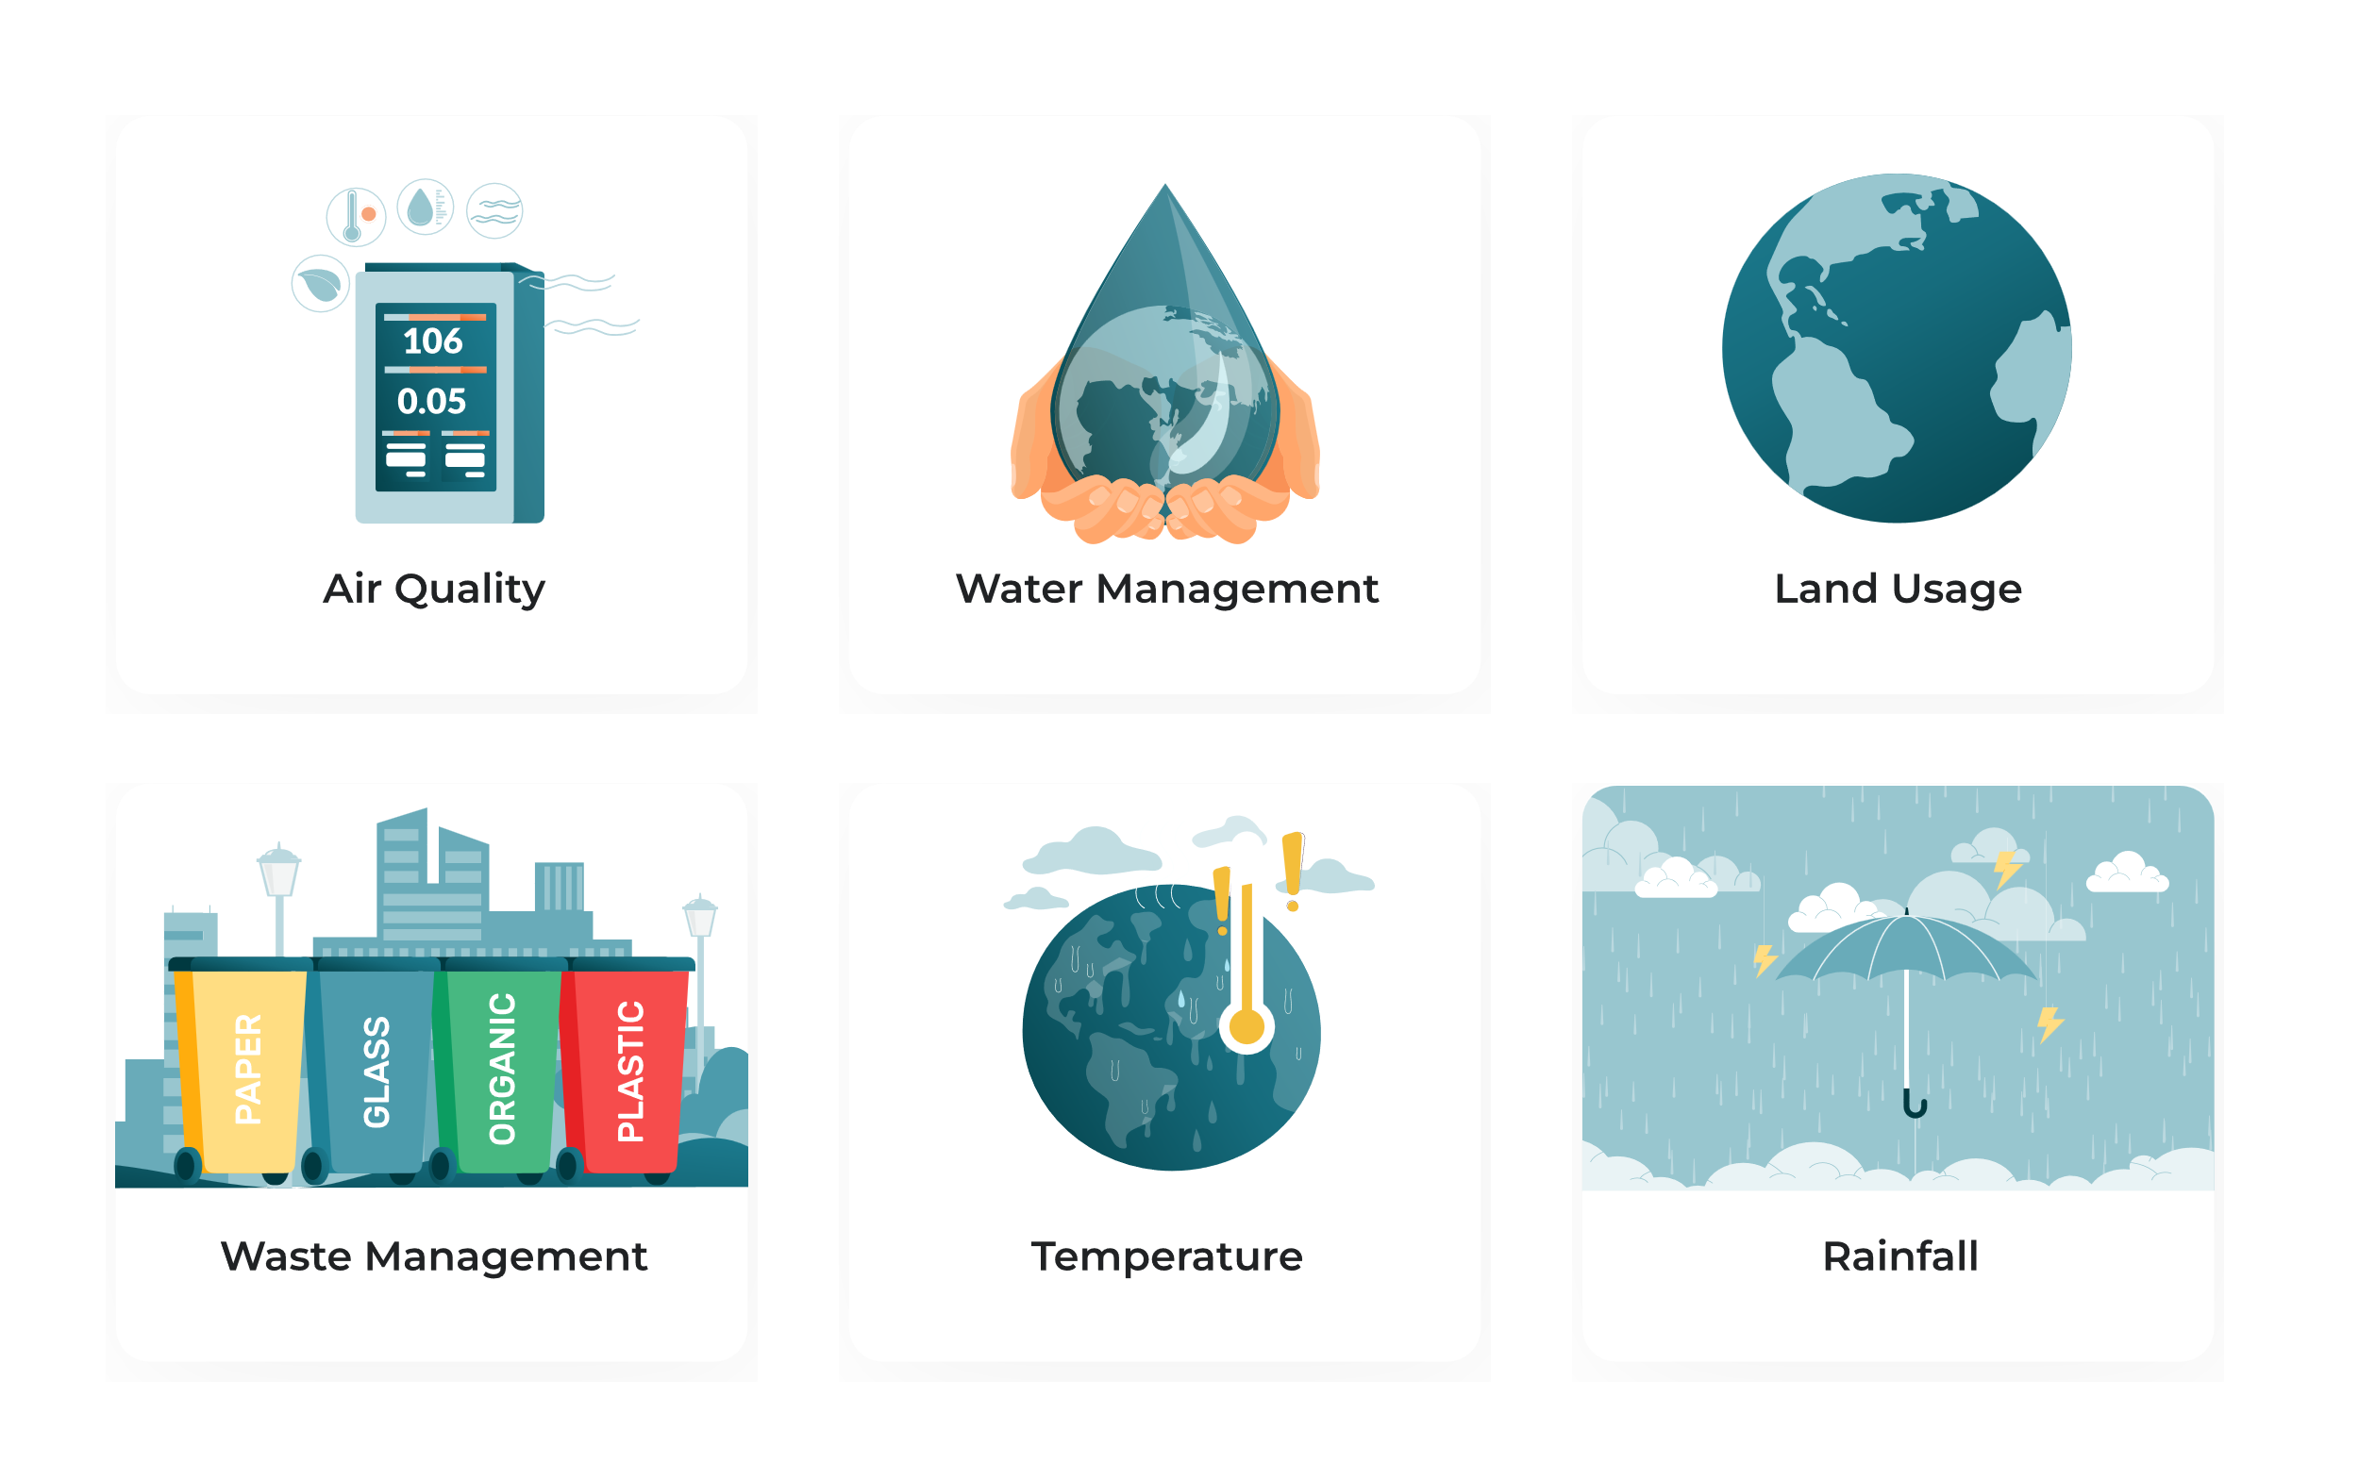













NATURE DIMENSION
Nature
Indicators
Air Quality
Earth
Water Management
Energy Usage
Climate Quality
Sub-indicators
Land Usage
Biodiversity
Green Cover
GHG Emissions
Rainfall
Waste Management
River & Lakes
Temperature & Humidity

Slide 11
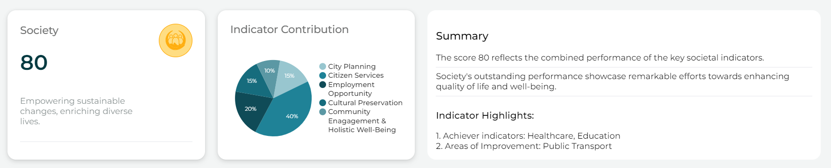










SOCIETY DIMENSION
Society
Indicators
City Planning
Citizen Services
Employment Opportunities
Cultural Preservation
Community Engagement & Holistic Well-Being
Sub-indicators
Healthcare
Transport
Education
Public Safety

Slide 12
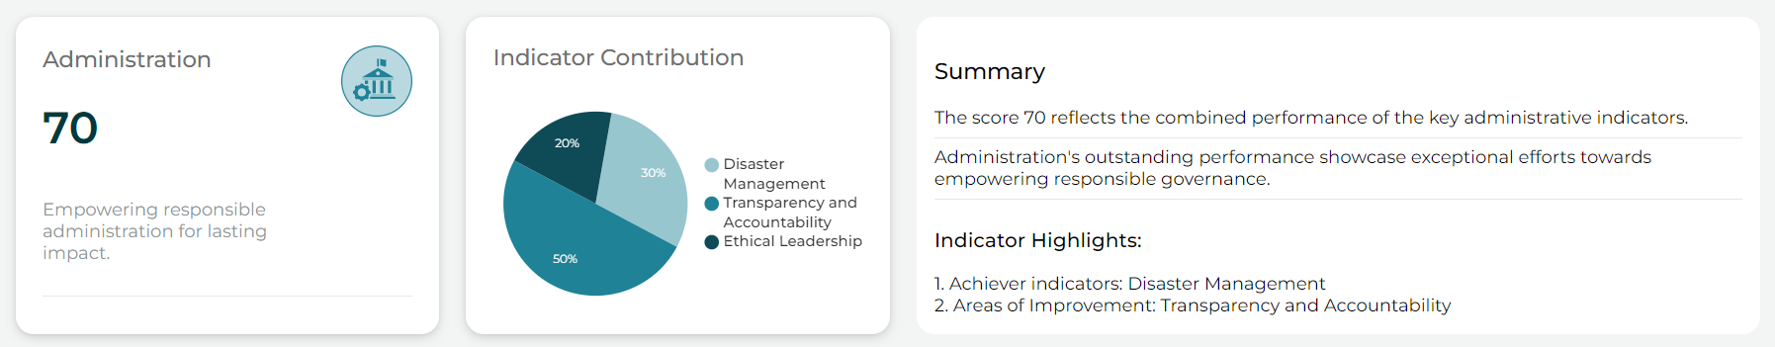
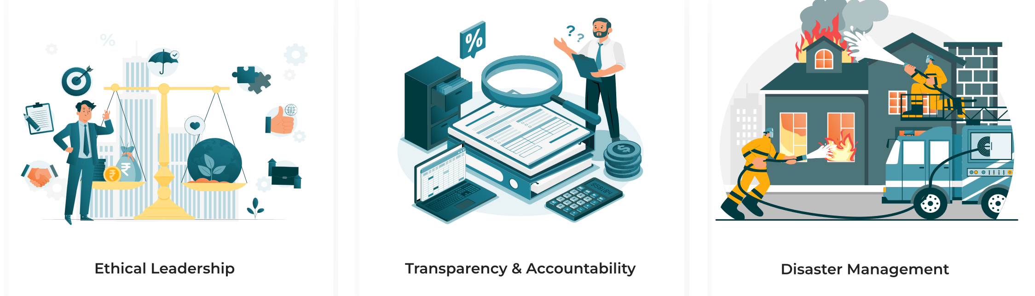







ADMINISTRATION DIMENSION
Administration
Indicators
Transparency & Accountability
Ethical Leadership
Disaster Management
Sub-indicators
Government Schemes
Budget and Expenditure
Anti-corruption
Citizen Rights

Slide 13

WAY FORWARD
The City Sustainability Index (CSI) will continue to drive sustainable urban development by fostering data-driven solutions that are tailored to each city's unique context, ensuring a resilient and inclusive future for all.
Empower cities with actionable insights to achieve SDGs and improve ESG performance.
Promote the integration of geospatial technologies and AI-driven analytics for smarter urban planning.
Preserve cultural heritage while advancing environmental stewardship and social equity.
Establish standard measures for sustainable urban living, guiding cities toward long-term sustainability.

Slide 14

Ayodhya – Leading City with Sustainability Index
Ayodhya, in collaboration with Arahas Technology Limited, is pioneering the world's first Vedic city powered by artificial intelligence (AI). The Ayodhya Development Authority (ADA) has partnered with Arahas to establish Ayodhya's sustainability through the Vedic City Sustainability Index. This index involves creating indicators to evaluate sustainability, aiming to develop a model city capable of efficiently managing waste through processing and recycling. Additionally, Ayodhya will implement a centralized dashboard to monitor and address environmental concerns, providing valuable insights for local authorities.
Notes:
Photo by Alif Ngoylung on Unsplash

Slide 15
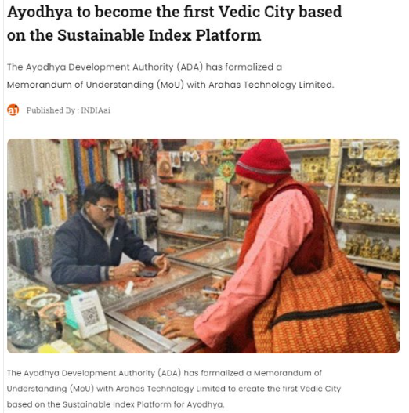

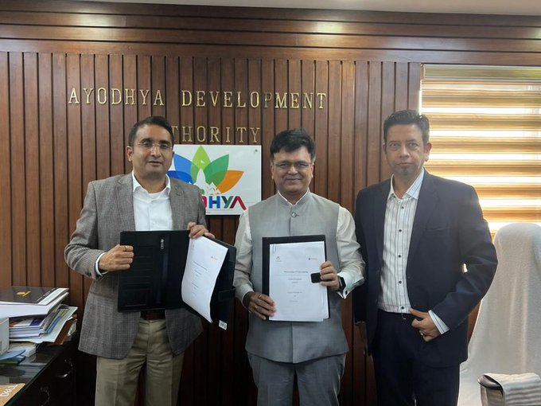

Slide 16
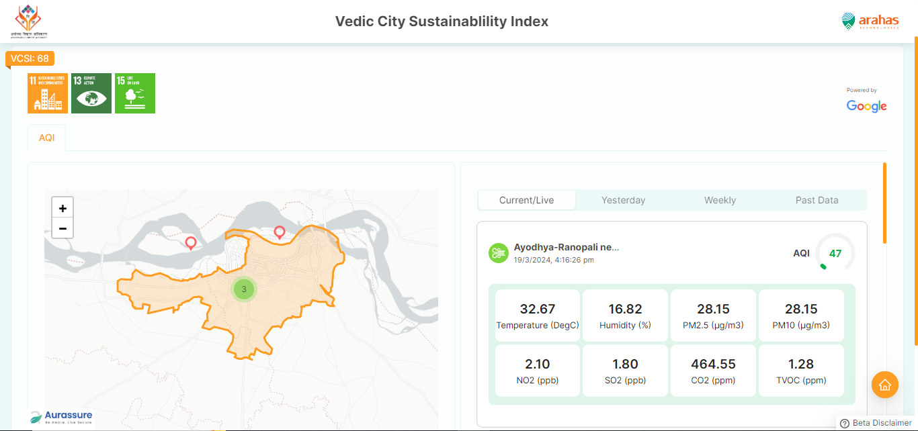

Slide 17
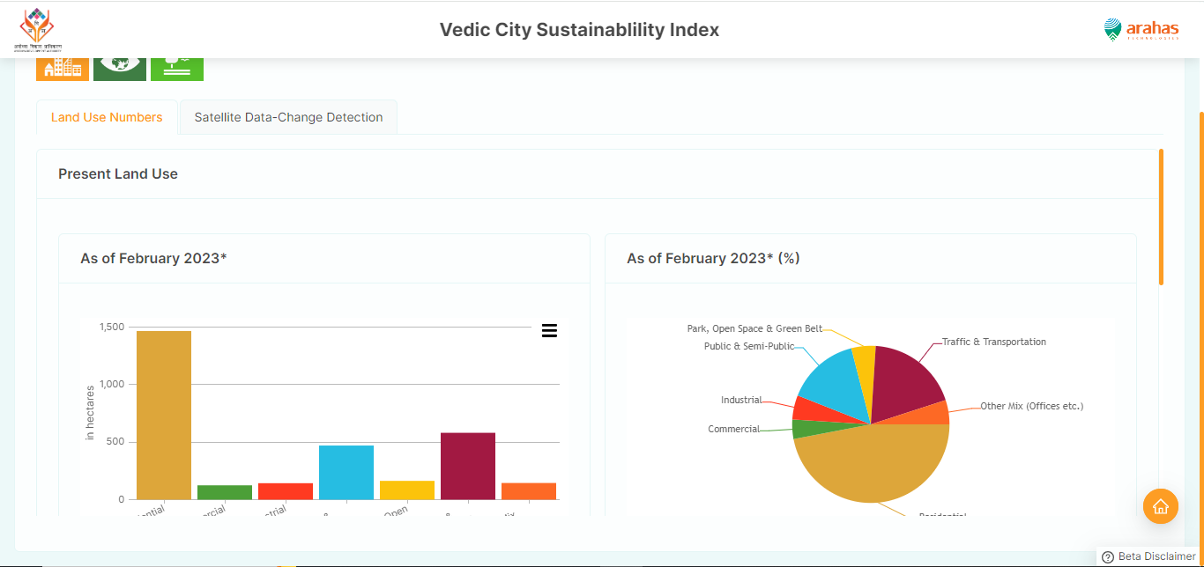

Slide 18
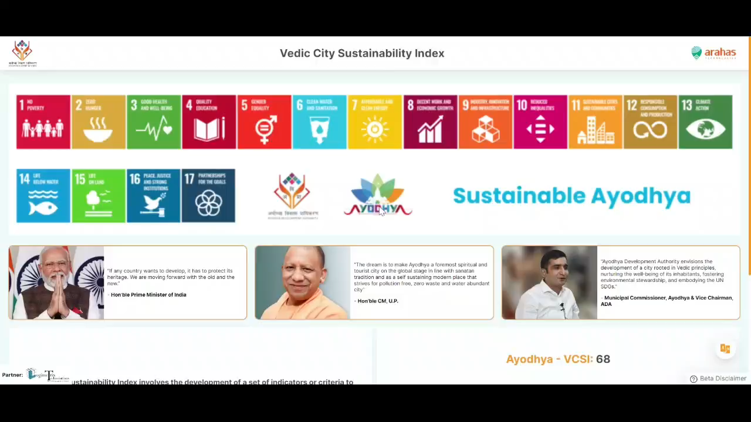

Slide 19
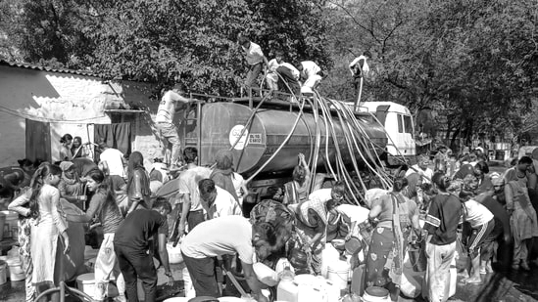
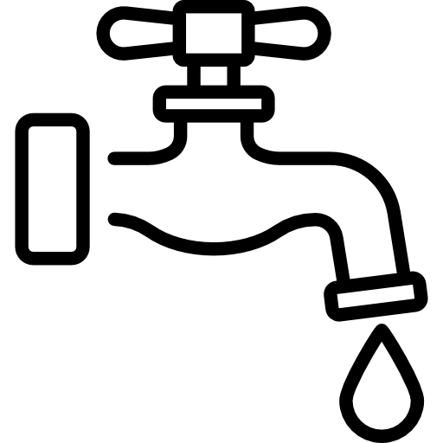

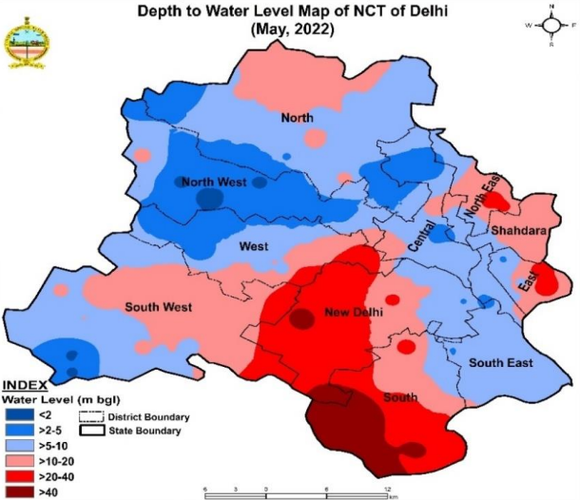




WATER MANAGEMENT
DELHI’S WATER CRISIS
Over extraction of groundwater
1,290 MGD
Requirement
Water Management Index
990-1000 MGD
Production
Sources of water
290 MGD
~23%
Shortage
Supply of water
Major Woes
Quality of water
Some areas claim to be getting only 2 hours per day of supply.
Water quality is non-drinkable.
Inability to tap surface water
Water usage
Source

Slide 20
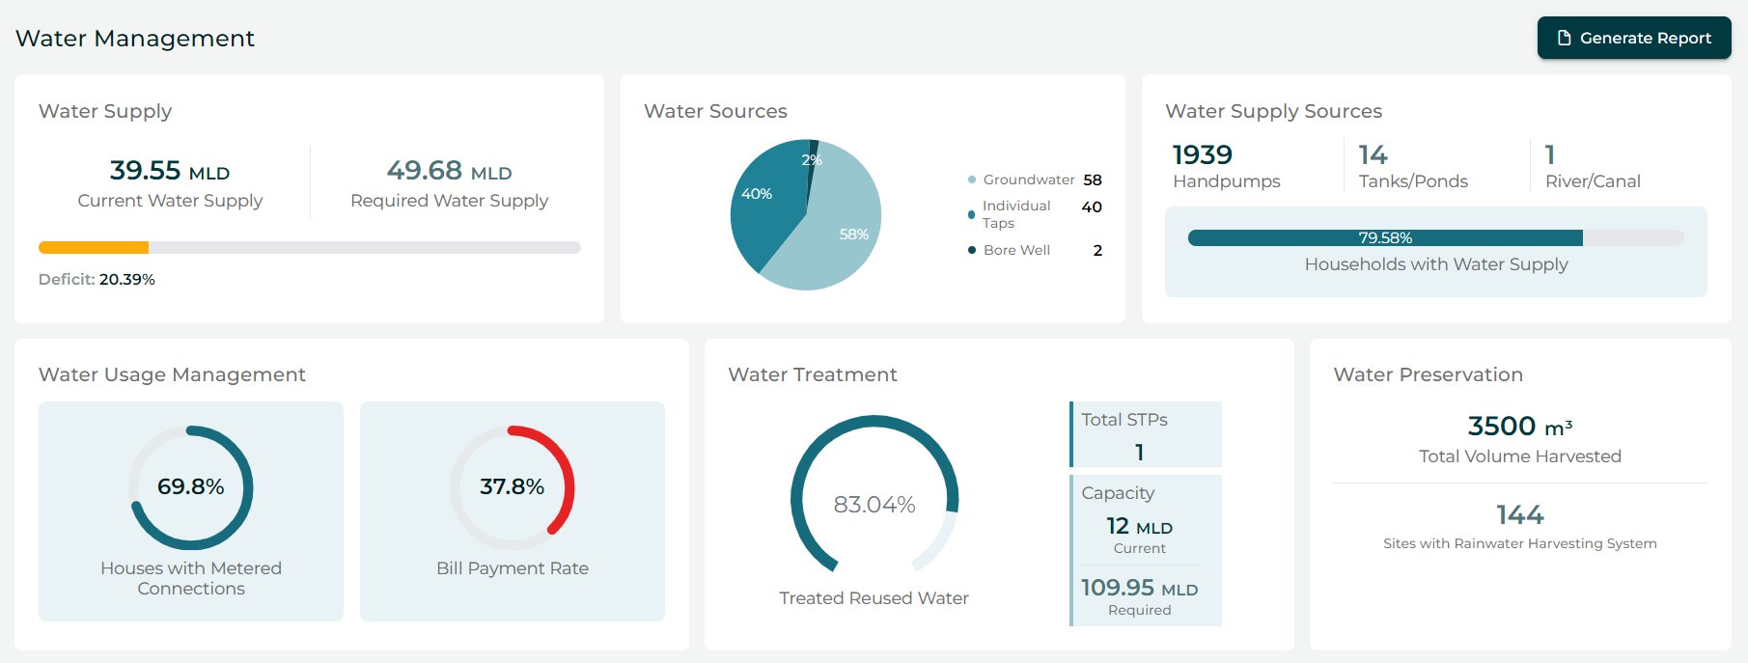
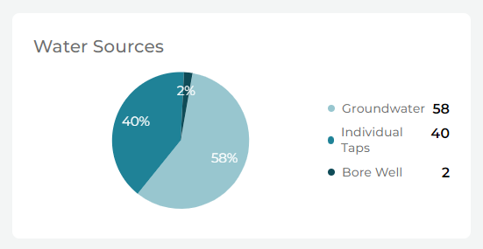
What’s on our dashboard?
Water Sources
Points out the dependencies of water sources

Slide 21

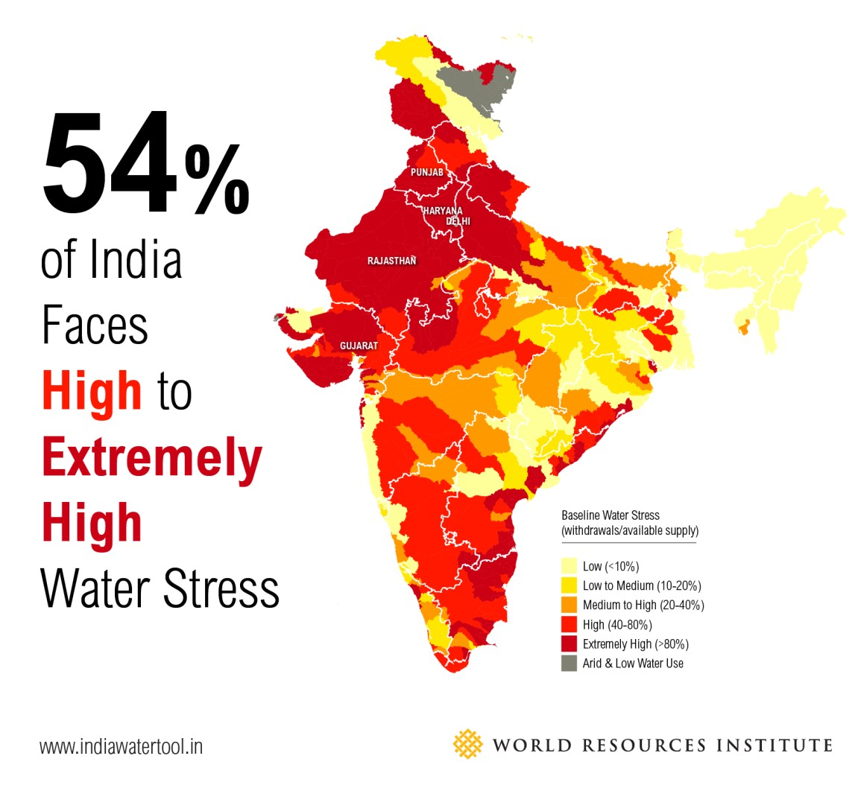


WATER MANAGEMENT
Water Management
By 2040,
1 in 4 children will live in extreme water shortage.
-World Bank
Water Management Index
54% of India faces
High to Extremely High
Water stress
Sources of water
No access to drinking water for 40% of Indians by 2030.
-NITI Ayog
Supply of water
Quality of water
Over 21% of India’s diseases are water-related.
-DPIIT
Water usage

